Slide 1
“
LiFi based Navigation System
”

Slide 2
What Is Li-Fi?
LiFi is a wireless optical networking technology that uses light-emitting diodes (LEDs) for data transmission. LiFi is designed to use LED light bulbs similar to those currently in use in many energy-conscious homes and offices.

Slide 3
Indoor Navigation:
An indoor navigation system is a system to find coordinates of objects or people inside a building using lights, radio waves, magnetic fields, acoustic signals, or other sensory information collected by mobile devices.

Slide 4
Indoor navigation using lifi:
LED lights emit visible light with location data and a embedded system or smartphone with a visible light receiver receives the data. The embedded system or smartphone calculates the optimal path to a designation.

Slide 5
Scope of the system:
Big warehouses/ Industries
Visually impaired people
Museums
Someone new at a particular constitution

Slide 6
Existing system:
Indoor navigation with beacons
Beacons are typically transmitters in client-based methods.
A beacon is a small Bluetooth radio transmitter, it repeatedly transmits a single signal that other devices can see, it broadcasts a radio signal. A Bluetooth-equipped device like a smartphone can “see” a beacon once it’s in range.

Slide 7
Cons of “Beacons”:
The Maintenance Problem
Beacons use Wi-Fi (which is easily hacked and the attacker can change the information stored in it)
Advertisements( push up notifications).

Slide 8
Features of Li-Fi:
Capacity
Bandwidth: The visible light spectrum is plentiful (10,000 more than RF spectrum), unlicensed and free to use.
Data density: Li-Fi can acheive about 1000 times the data density of Wi-Fi because visible light can be well contained in a tight illumination area whereas RF tends to spread out and cause interference.
High speed: Very high data rates can be achieved due to low interference, high device bandwidths and high intensity optical output.
Planning: Capacity planning is simple since there tends to be illumination infrastructure where people wish to communicate, and good signal strength can literally be seen.
Efficiency
Low cost: Requires fewer components than radio technology.
Energy: LED illumination is already efficient and the data transmission requires negligible additional power.
Safety
Safe: Life on earth has evolved through exposure to visible light. There are no known safety or health concerns for this technology.
Non-hazardous: The transmission of light avoids the use of radio frequencies which can dangerously interfere with electronic circuitry in certain environments.
Security
Containment: It is difficult to eavesdrop on Li-Fi signals since the signal is confined to a closely defined illumination area and will not travel through walls.

Slide 9
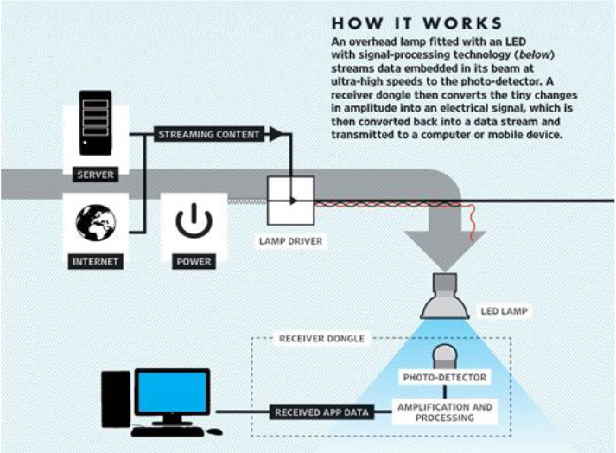
Working :

Slide 10
Here it consists of two units:
1. Transmitter unit
2. Receiver unit
The led’s are acting as a transmitter unit fitted to the wall/ceiling. This Led’s are driven by microcontroller.
In the transmitter the modulated information can be collected through LED matrix.
The receiver unit which consist a Li-Fi sensor demodulates the en-coded binary data and generate original data.
The receiver unit consist a photo transistor which receives the information from the LED matrix connected to the transmitter.
The information is stored in the microcontroller and can be sent to PC using a simple protocol of serial communication.

Slide 11
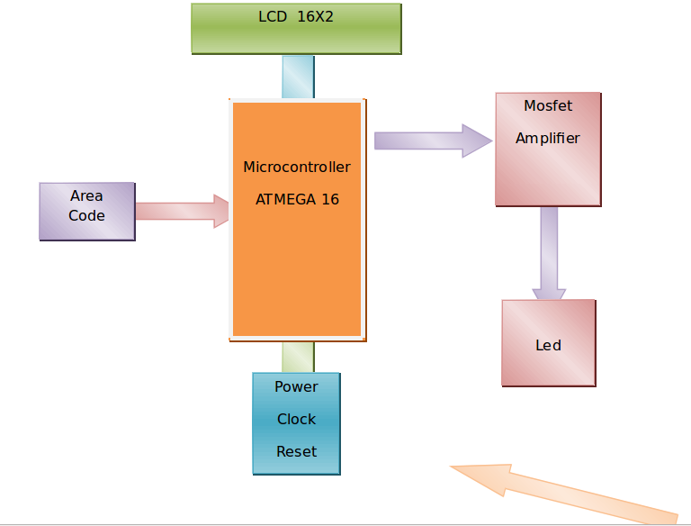

Slide 12
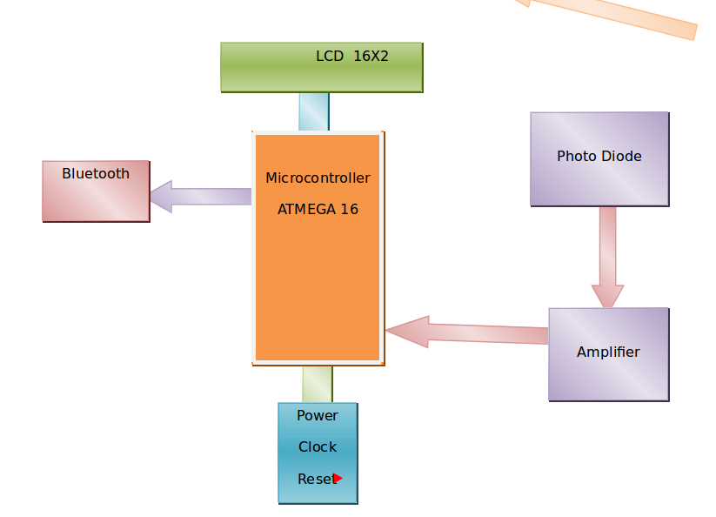

Slide 13
Conclusion :
With the growing technology and increasing use of the net services, prospects area unit terribly high that use of Li-Fi technology are shortly in apply. The construct of Li-Fi is spreading thus quick because it is simple to use, it's attracting interest of individuals. the utilization of Li-Fi technology provides a awfully golden chance to interchange or to administer various to the radio based mostly wireless technologies. B ecause the range of individuals and also the access of web is incre asing on such an outsized scale , accessing web through Wi-Fi can shortly be lean because the usage is increasing however the information measure remains an equivalent.

